Slide 1
Uniforms & Fog

Slide 2
Uniforms
A uniform is a global Shader variable declared with the "uniform" storage qualifier. These act as parameters that the user of a shader program can pass to that program. Their values are stored in a program object.
Uniforms are so named because they do not change from one shader invocation to the next within a particular rendering call. This makes them unlike shader stage inputs and outputs, which are often different for each invocation of a shader stage.

Slide 3
glUniform
At its most basic glUniform takes in a location
Specifies the location of the uniform variable to be modified.
For the vector and matrix commands, specifies a pointer to an array of count values that will be used to update the specified uniform variable.
glUniform modifies the value of a uniform variable or a uniform variable array. The location of the uniform variable to be modified is specified by location, which should be a value returned by glGetUniformLocation.

Slide 4
glGetUniformLocation
At its most basic glGetUniformLocation take in a (shader) program
Specifies the program object to be queried.
Name (of uniform)
Points to the name of the uniform variable whose location is to be queried.
glGetUniformLocation returns an integer that represents the location of a specific uniform variable within a program object. Name must be an active uniform variable name in program.
We can either create a getter in our shader class that return the Gluint that tracks the current shader program to specify the program object to be queried, or we can create setters within a shader program class.

Slide 5
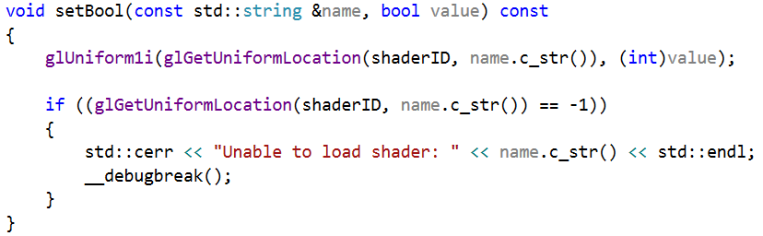
Uniforms – Method to send data

Slide 6
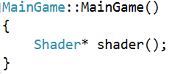
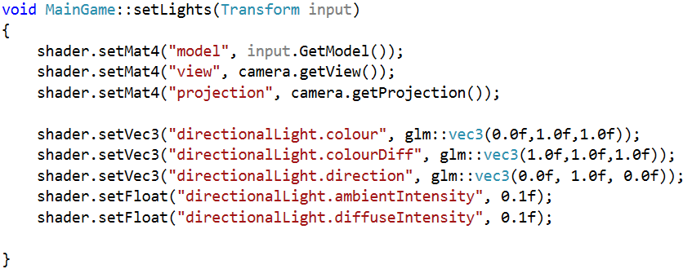
Uniforms – Send data in application

Slide 7
Fog
We are all familiar with fog. On a foggy day, it might be impossible to see more than a few feet in front of us, and dense fog can present danger. However, even when fog is not heavy, it’s still there — you may just need to look further to see it.
Fog is caused by water vapor hanging in the air or by other gases or particles such as smoke or pollution.

Slide 8
Fog
As light travels through the air, two things happen:
some of the light is absorbed by the particles, and some bounces off the particles (or is possibly re-emitted by those particles).
As light is absorbed by fog, this is known as extinction as eventually all of the light will have been absorbed and none will be left.
However, light will generally find a way to get out of the fog as it will bounce around and be absorbed and re-emitted by the fog particles.
We call this inscattering and we can build a simple model of both extinction and inscattering to produce a simple yet effective simulation of fog.

Slide 9
Fog
A simple fog effect can be achieved by mixing the colour of each fragment with a constant fog colour.
The amount of influence of the fog colour is determined by the distance from the camera.
We could use either a linear relationship between the distance and the amount of fog colour, or we could use a non-linear relationship such as an exponential one.
The following image shows four teapots rendered with a fog effect produced by mixing the fog colour in a linear relationship with distance.

Slide 10
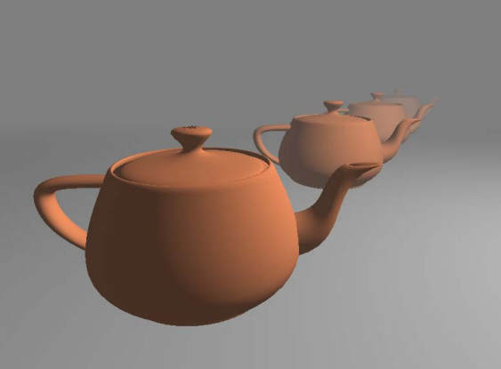
Fog

Slide 11

Fog
To define this linear relationship we can use the following equation:
In the preceding equation,
dmin is the distance from the eye where the fog is minimal (no fog contribution)
dmax is the distance where the fog color obscures all other colors in the scene.
The variable z represents the distance from the eye.
The value f is the fog factor.
A fog factor of zero represents 100% fog, and a factor of one represents no fog. Since fog typically looks thickest at large distances, the fog factor is minimal when |z| is equal to dmax, and maximal when |z| is equal to dmin.

Slide 12
Fog
Note, using this method...
Since the fog is applied by the fragment shader, the effect will only be visible on the objects that are rendered. It will not appear on any "empty" space in the scene (the background). To help make the fog effect consistent, you should use a background color that matches the maximum fog color.

Slide 13
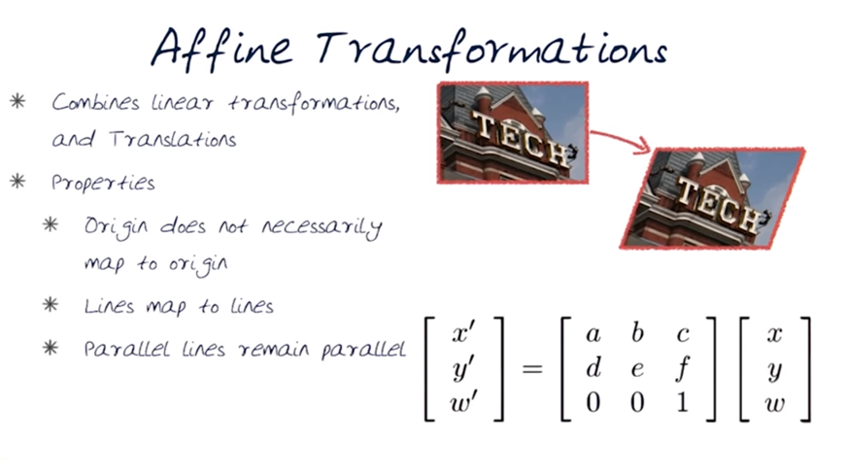
Fog

Slide 14
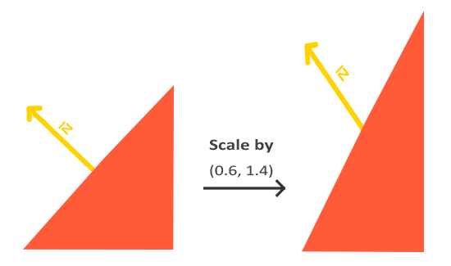
Normal Matrix

Slide 15
Normal Matrix
Whenever we apply a non-uniform scale (note: a uniform scale only changes the normal's magnitude, not its direction, which is easily fixed by normalizing it) the normal vectors are not perpendicular to the corresponding surface anymore which distorts the lighting.
The trick of fixing this behavior is to use a different model matrix specifically tailored for normal vectors. This matrix is called the normal matrix and uses a few linear algebraic operations to remove the effect of wrongly scaling the normal vectors. If you want to know how this matrix is calculated I suggest the following article.

Slide 16
Fog
The vertex shader has two output variables: Position and Normal. In the main function, we convert the vertex normal to eye coordinates by transforming with the normal matrix, and then store the converted value in Normal. Similarly, the vertex position is converted to eye coordinates by transforming it by the model-view matrix, and the converted value is stored in Position.
The values of Position and Normal are automatically interpolated and provided to the fragment shader via the corresponding input variables.

Slide 17
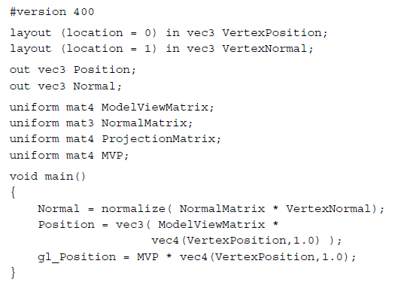
Fog Vertex Shader
// two output variables
// convert the vertex normal to eye coordinates (camera space) by transforming with the normal matrix
// vertex position is converted to eye coordinates by transforming
it by the model-view matrix

Slide 18
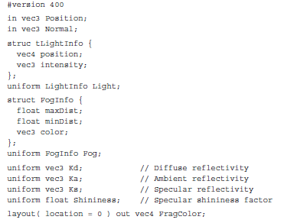
Fog Fragment Shader
// minDist is the distance from the eye to the fog's
starting point,
//maxDist is the distance to the point where
the fog is maximal.

Slide 19
Fog Fragment Shader
The variable dist is used to store the distance from the surface point to the eye position. The z coordinate of the position is used as an estimate of the actual distance. The variable fogFactor is computed using the preceding equation. Since dist may not be between minDist and maxDist, we clamp the value of fogFactor to be between zero and one.
We then call the function ads to evaluate the basic ADS shading model. The result of this is stored in the variable shadeColor.
Finally, we mix shadeColor and Fog.color together based on the value of fogFactor, and the result is used as the fragment color.

Slide 20
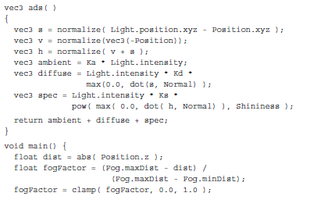

Fog Fragment Shader
ADS calculations (week 6)
// abs — return the absolute value of the parameter
// mix shadeColor and
Fog.color together based on the value of fogFactor

Slide 21
Computing distance from the eye
We could also use the absolute value of the z coordinate as the distance from the camera. This may cause the fog to look a bit unrealistic in certain situations. To compute a more precise distance, we could replace the line:
float dist = abs( Position.z );
with the following.
float dist = length( Position.xyz ); (calculate the length of a vector for accuracy)a
Of course, the latter version requires a square root, and therefore would be a bit slower in practice.

Slide 22


Fog
In this recipe we used a linear relationship between the amount of fog colon and the distance from the eye. Another choice would be to use an exponential relationship. For example, the following equation could be used:
In the above equation, d represents the density of the fog. Larger values would create "thicker" fog. We could also square the exponent to create a slightly different relationship (a faster increase in the fog with distance).

